Slide 1
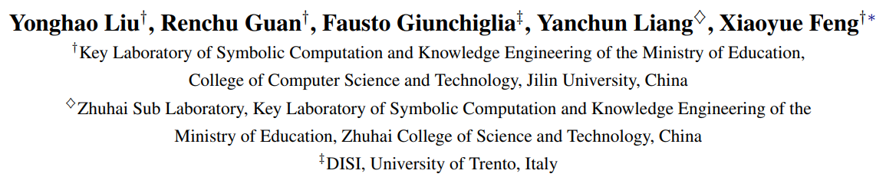





Deep Attention Diffusion Graph Neural Networks for Text Classification
EMNLP 2021
Reported by 何烨，邹世豪

Slide 2
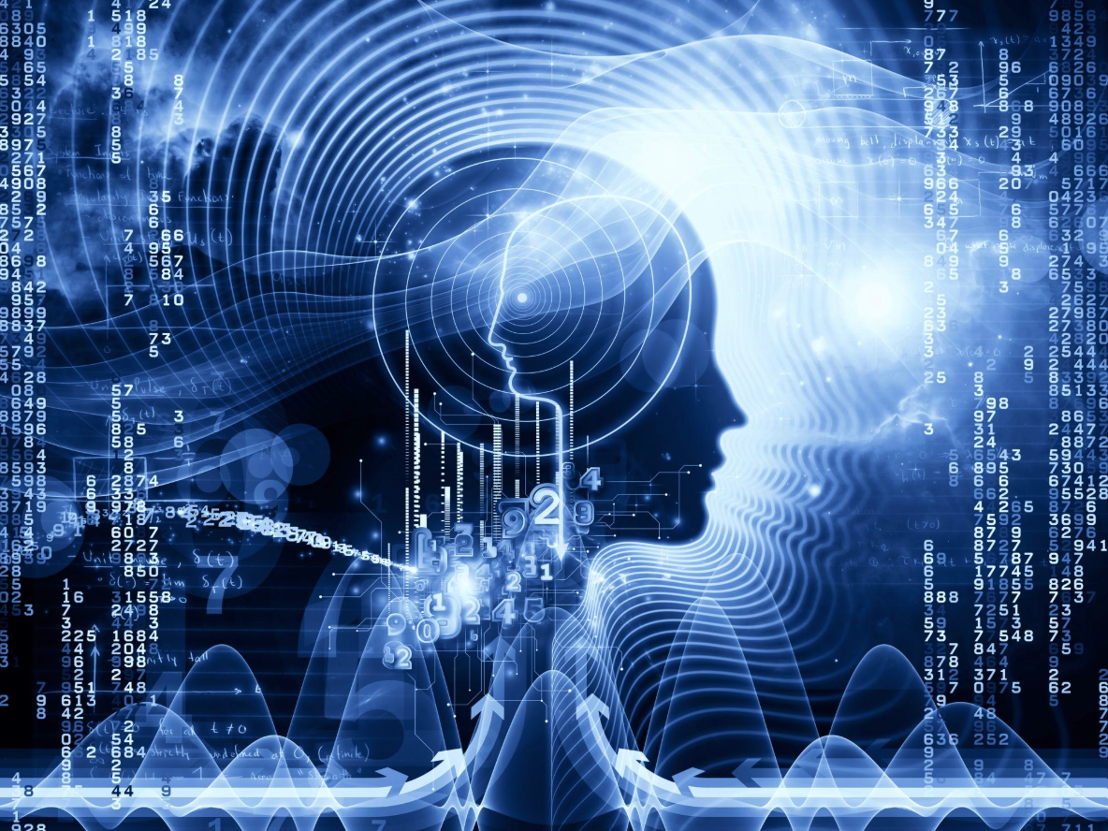
1. Introduction
2. Method
3. Experiments
4. Conclusion

Slide 3
Introduction
Motivation:
1. Restricted Receptive Fields.
2. Shallow Layers
3. Non-Precision Document-Level Representations
4. Low-Pass filter

Slide 4
Introduction
Contribution:
1. DADGNN,based on the attention diffusion and decoupling technique, which has excellent expressive power in modeling documents and overcomes some limitations of conventional graph-based models.
2. We theoretically prove that the attention diffusion operation is equivalent to a polynomial graph filter that can utilize both high- and low-frequency graph signals.
3. We conduct extensive experiments on a series of benchmark datasets, and have the state-of-the-art performance of DADGNN .

Slide 5
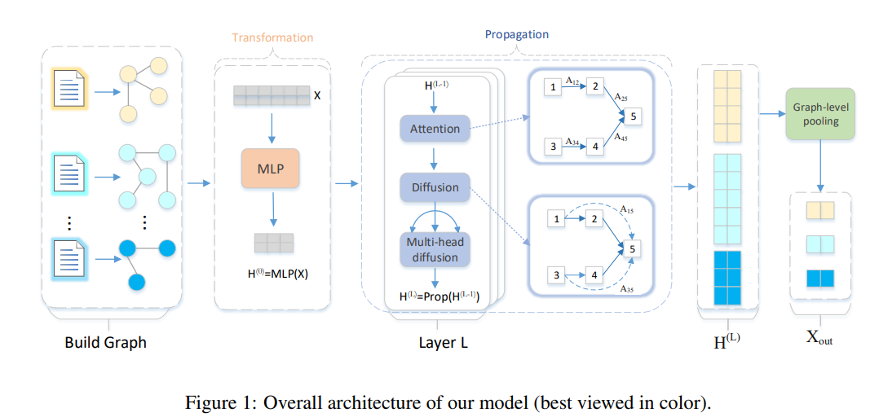
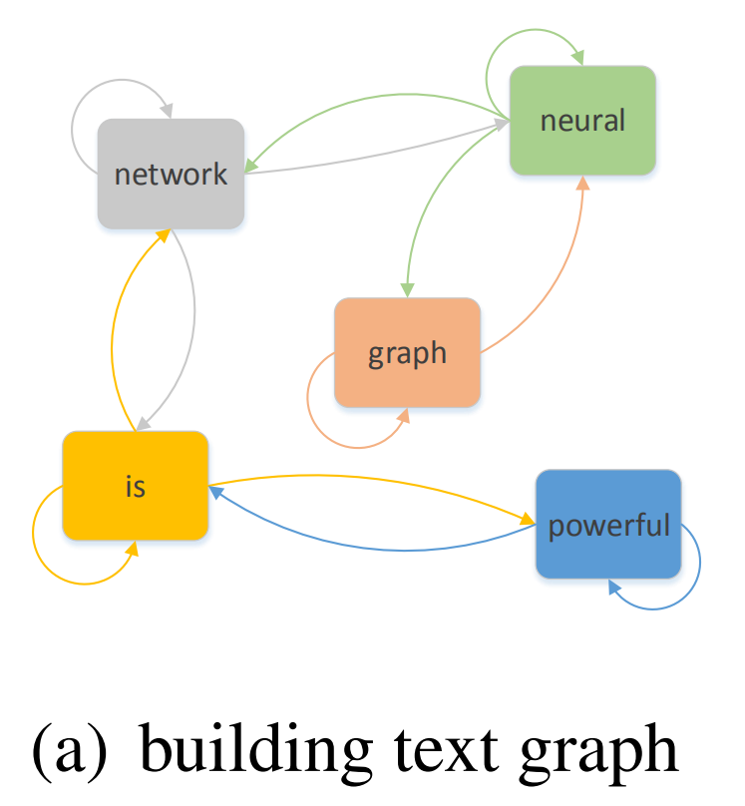
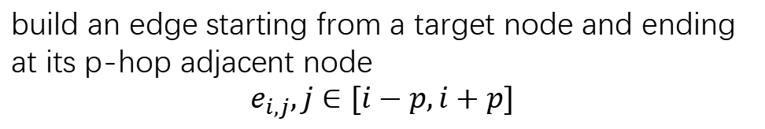
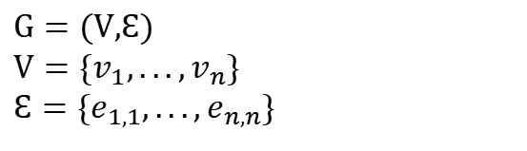
Method
text graph construction
$$G=(\text{V}\text{,}Ɛ) \\ V=\{v_{1},...,v_{n}\} \\ Ɛ=\{e_{1,1},...,e_{n,n}\}$$
build an edge starting from a target node and ending at its p-hop adjacent node
$$e_{i,j},j∈[i−p,i+p]$$

Slide 6
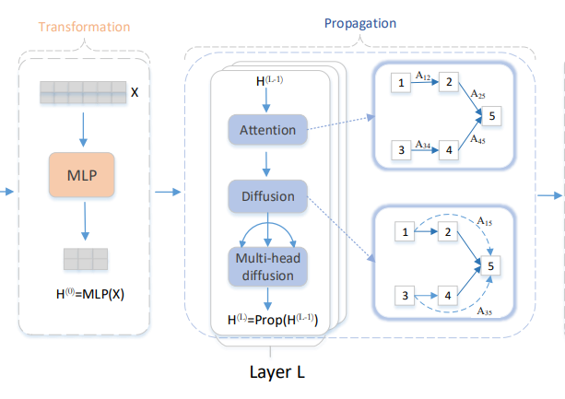
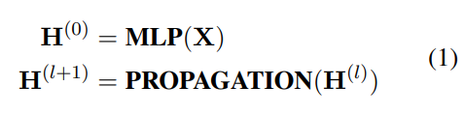
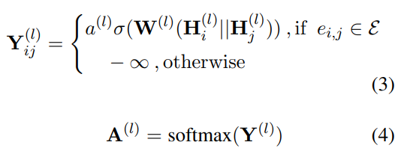

Method
Decouple GNN
calculate the normalized attention weights between directly connected nodes
The forward propagation process of previous
graph-based models

Slide 7
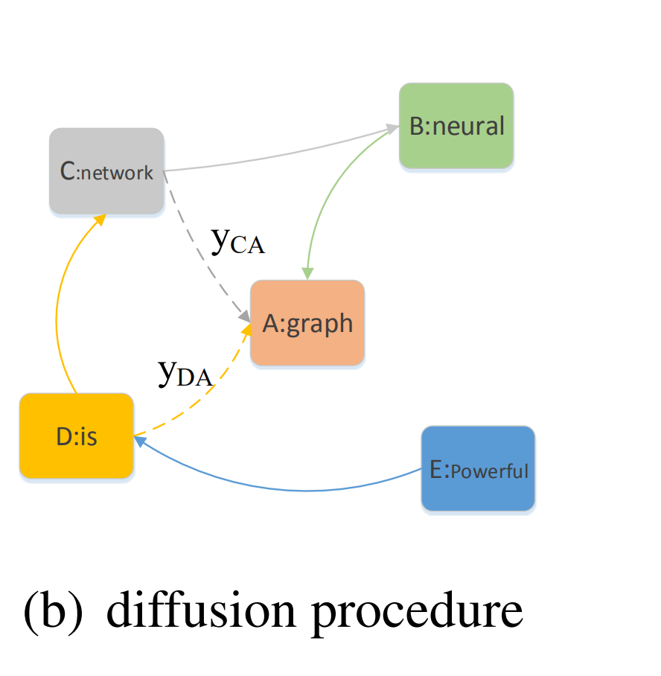
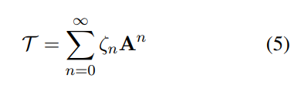
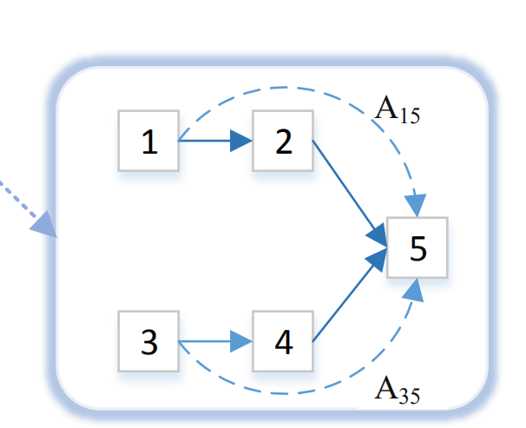

Method
Attention Diffusion matrix:
Multi-head diffusion:

Slide 8
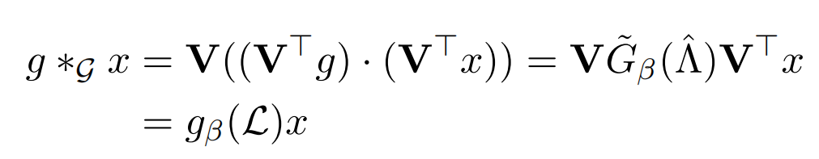
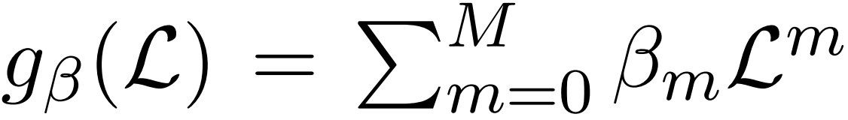
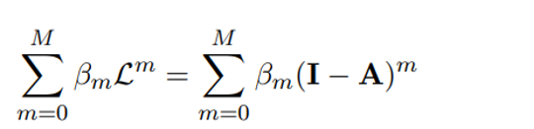
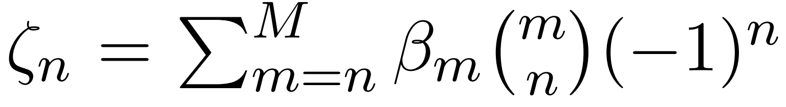
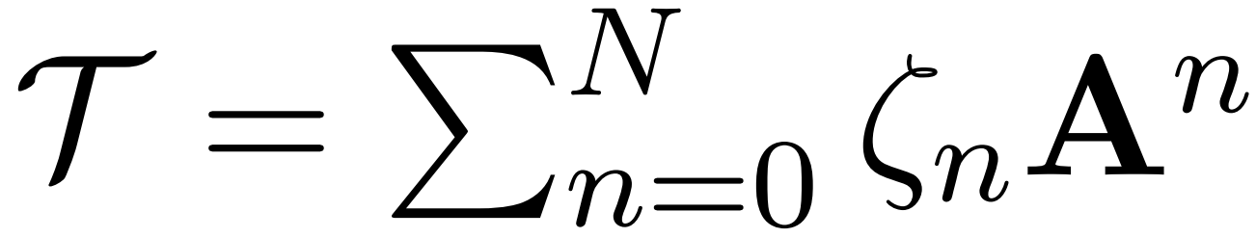

Method

Slide 9
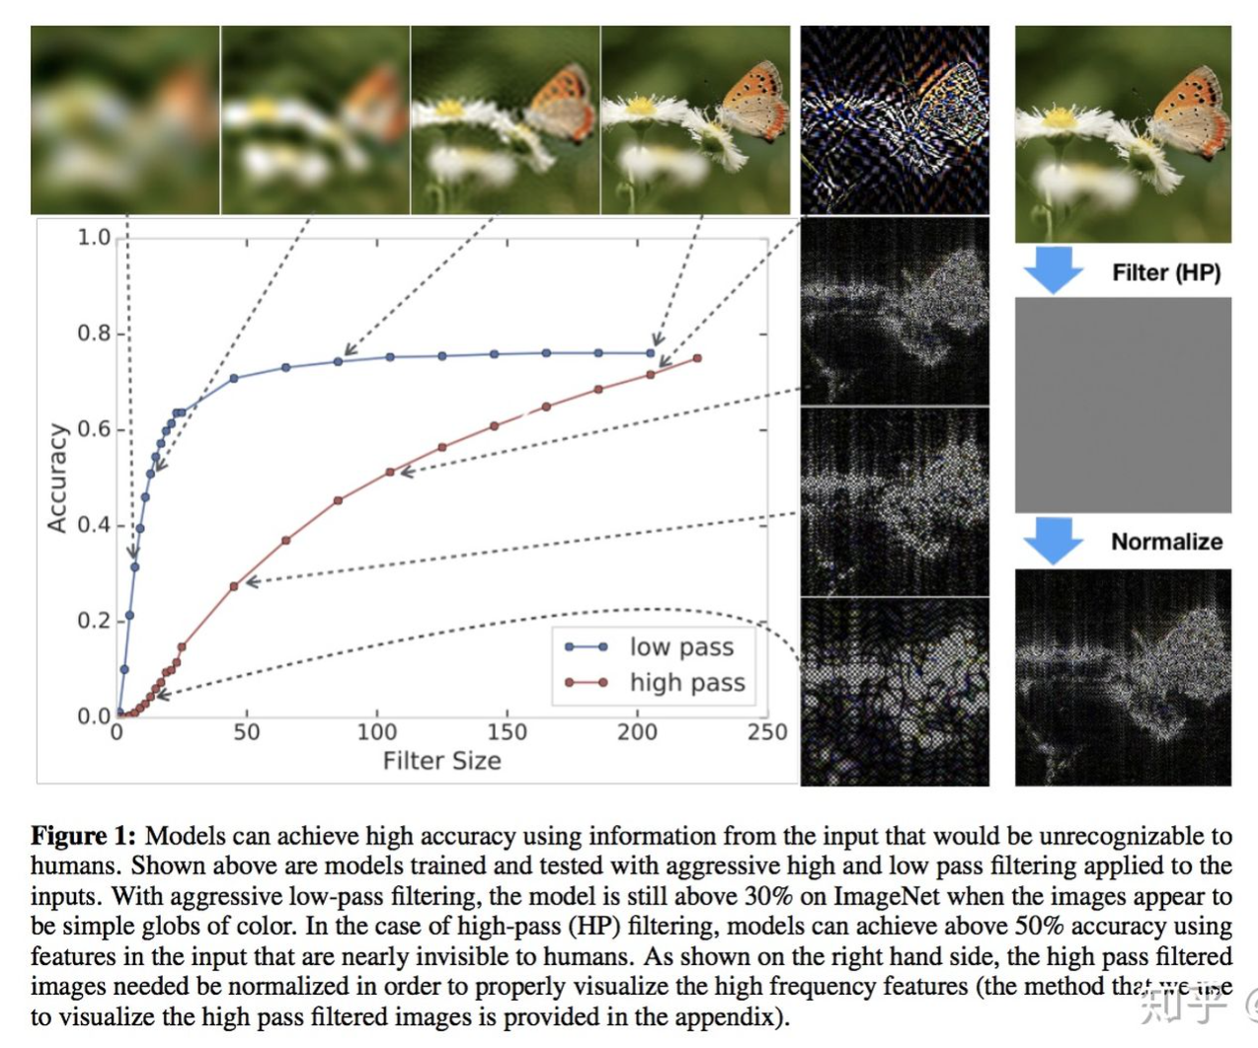
Filter

Slide 10
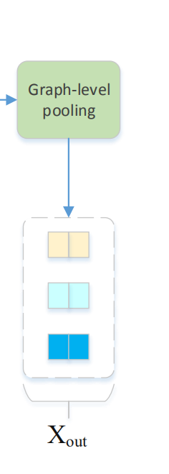
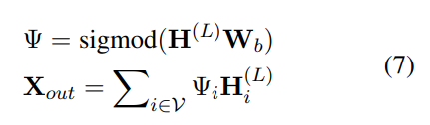

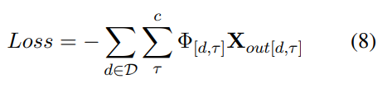
Method
Graph-Level Representation
cross-entropy

Slide 11
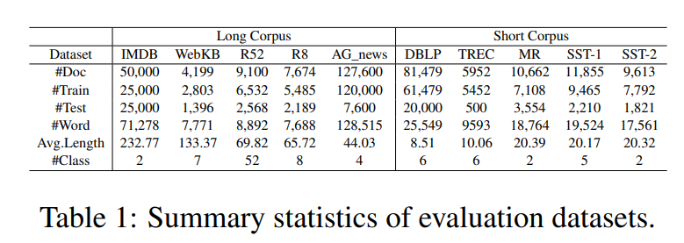
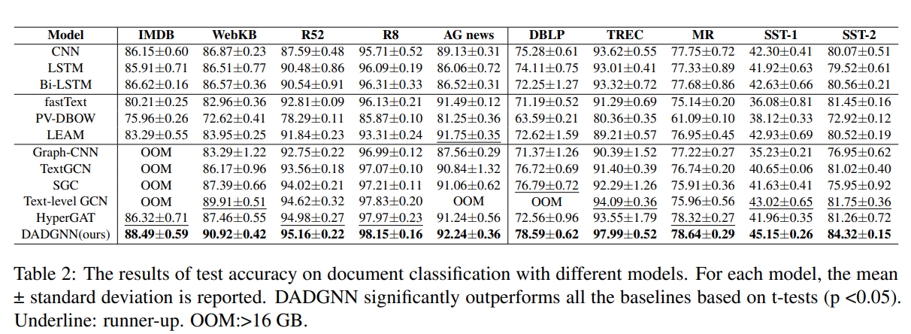
Experiments
Datasets and Result

Slide 12
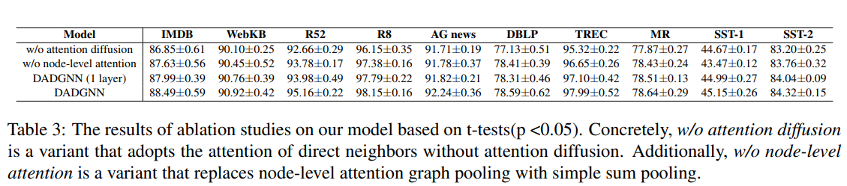
Experiments
Ablation Study

Slide 13
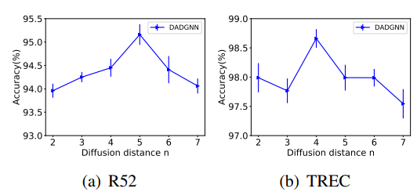
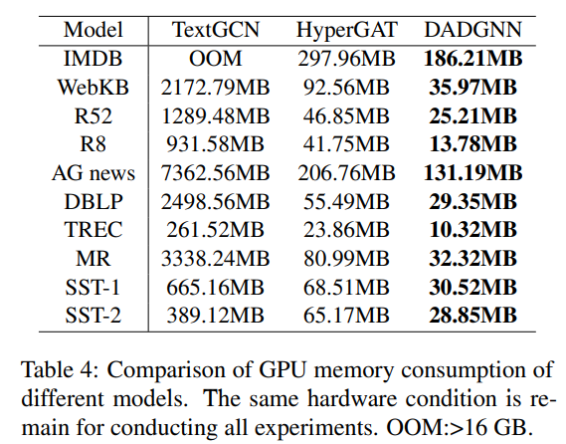
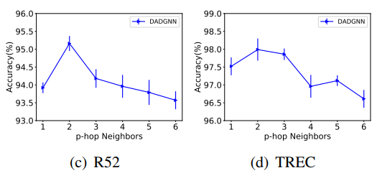
Experiments
Memory Consumption
Hyperparameter sensitivity

Slide 14
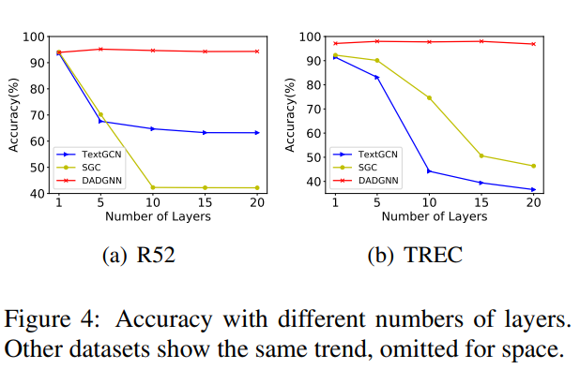
Experiments
Deeper layers

Slide 15
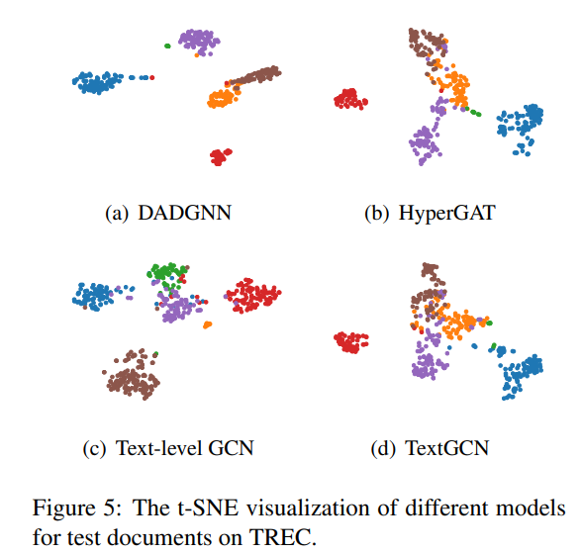
Experiments
Visualization

Slide 16
Conclusion
Propose a new graph-based model, named DADGNN, for text classification. Decouples the necessary procedures of GNNs to train a deep neural network and introduces a attention diffusion mechanism to capture non-direct-neighbor context information in a single layer. Furthermore, the node-level attention technique is introduced to obtain more precise document-level representations.

